Slide 1
The role of the Student Counselling Service at
ATU Donegal

Slide 2
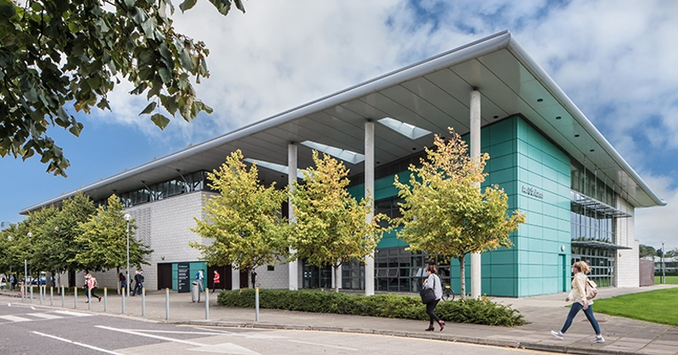
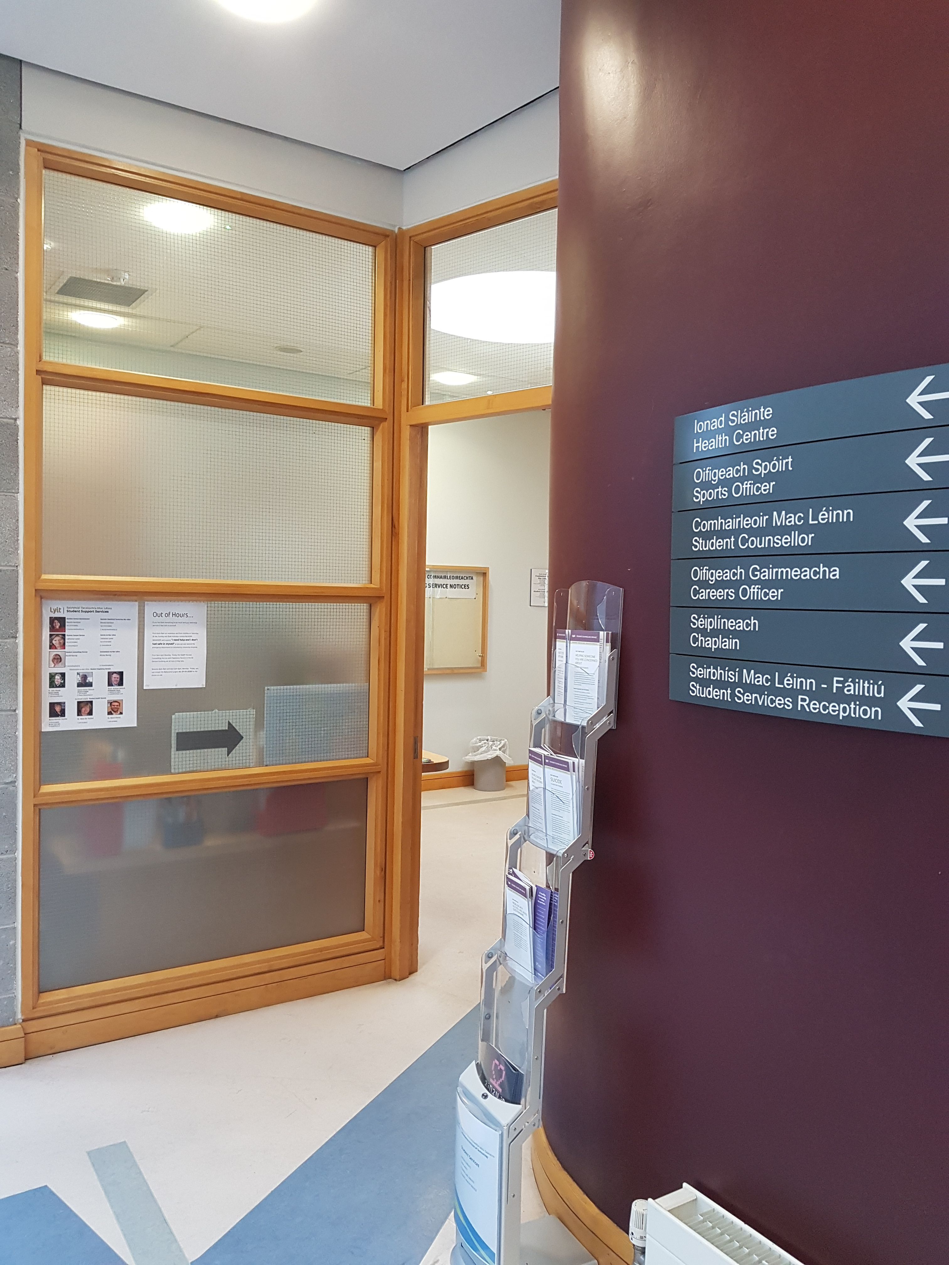
The Student Counselling Service has two Counsellors, one based in the Student Support Suite, An Dánlann and one in the Annex. Other Services available in the Student Services Suite are: Health, Careers and Chaplaincy
Atlantic Technological University

Slide 3
Services provided by the Student Counselling Service:
Initial assessment appointments.
One-to-one sessions by appointment.
Referral to specialist / appropriate community agencies.
Consultations with staff regarding concerns about students.
Workshops to raise awareness about student mental health and well-being.
Participation in student adjustment programmes and initiatives such as induction and orientation.
Atlantic Technological University

Slide 4
How can the Student Counselling Service help Staff?
Telephone or one to one consultation with staff re their concerns about students.
Advice on how best to support students in distress.
Collaboration with staff on initiatives to support the wellbeing and mental health of students.
Atlantic Technological University

Slide 5
Identifying Students in Distress
Academic:
Inconsistent work, poor quality work, disorganised presentation of assignments, requesting multiple extensions, repeated cancelling or not turning up for scheduled meetings.
Behavioural:
Dramatic change in behaviour, noticeable lack of interest in hygiene, withdrawal from engagement in class, noticing anxiety, when doing a presentation, or avoidance of presentations due to anxiety, signs of substance misuse.
Interpersonal:
Social withdrawal or isolation, absenteeism,
complaints from peers regarding student behaviour.
Atlantic Technological University

Slide 6
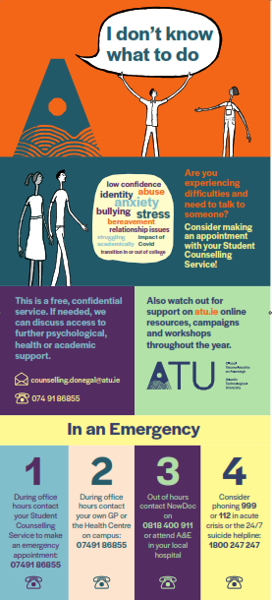
Referring a Student for Counselling
Discuss possible referral with student
↓
Emphasise the Counselling Service is confidential
↓
Provide student with information about how to access the Counselling Service
↓
Accompany student to the Counselling Service if concerned for their safety
Further information about how to make a referral is available on our website
https://www.lyit.ie/Student-Hub/Health-Wellbeing/Student-Counselling-Service/Information-For-LYIT-Staff
Tel: 074 9186855
Call to Student Service Reception, An Dánlann during office hours 9.30am to 5pm

Slide 7
Contact details for the Student Counselling Service
Students can arrange appointments by:
Email: counselling.donegal@atu.ie
Tel: 074 9186855
or call into the reception at Student Services Suite, 1st floor An Dánlann between 9.30am to 5pm
EMERGENCIES WILL BE SEEN ON THE DAY
Atlantic Technological University
Atlantic Technological University

Slide 8
Importance of Staff Collaboration
with the Student Counselling Service
Research indicates:
Approx. 20% of students who need support actually seek help.
1 in 3 students seeking help from college counsellors have considered attempting suicide.
Students who withdraw from college in their first year did not feel able to access help independently.
Students have a tendency to identify individual staff as central in providing support, over specific services.
Counselling within the college is effective in reducing student psychological distress and facilitating students continuing their studies.
Atlantic Technological University

Slide 9
All staff across the University community, who have any contact with students,
have a role to play in supporting student mental health.
We welcome…
staff feedback, suggestions and collaboration to help us to:
reach students in distress who might need counselling
promote student psychological health and well-being.
Atlantic Technological University
Further Information about the Student Counselling Service http://www.lyit.ie/studentlife/studentservices/counselling/

